Slide 1
Linear Regression
in Machine Learning-

Slide 2
Linear Regression:-
Linear Regression is a Method of predicting Model accuracy in Machine Learning.
It allows us to understand the strength of relationship between variables.
It inform us that what predictor in a Model are statistically important or not.
It also give information about available coefficient.
Linear Regression basically two types are:-
Simple Linear Regression - Multiple Linear Regression

Slide 3
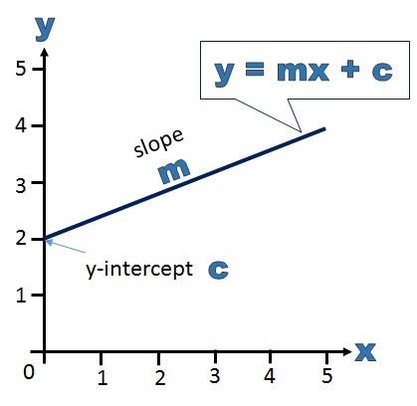
Simple Linear Regression:-
Simple Linear Regression is the one which contains only one variable (features) in dataset. It basically work on equation ( y= mx + c ). As you can see below the explanation of it.

Slide 4
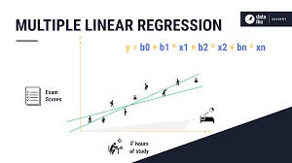
Multiple Linear Regression:-
Multiple Linear Regression always contains different Variables (features) in dataset. Also it works on the basis of equation ( y = m1x1 + m2x2 + mnxn + c).

